Slide 1
OS’26-27 Project
PART II: GROUP MODULES
(Dynamic Allocator, Kernel Heap, fault handler i, BLOCKING)

Slide 2
Agenda
PART 0: ROADMAP
PART I: PREREQUISITES
PART II: GROUP MODULES
PART III: INDIVIDUAL MODULES
PART IV: OVERALL TESTING & BONUSES

Slide 3
Agenda
PART II: GROUP MODULES
  Dynamic Allocator
  Kernel Heap
  Fault Handler I (Placement)
  Blocking

Slide 4
Project Overview
[TW] Prerequisite Modules
Dyn. Alloc, Kern Heap, Fault Handl. 1, Blocking
[M#1]
Fault Handl. 2
[M#5]
IPC #2
Individual Module#1
Individual Module#2
[M#2]
User Heap
Individual Module#3
Individual Module#4
[M#6]
Shared Memory
[M#3]
CPU Sched.
[M#4]
IPC #1
[TW] Integration & Overall Testing
Scenarios & Bonuses
Notes:
Inshaa’ALLAH

Slide 5

Dynamic Allocator
PART II: group modules

Slide 6
Objective
Dynamically allocate/free small-size blocks in the heap using FAST and MEMORY-EFFICIENT way either for OS or any user program

Slide 7
Dynamic Allocator – Functions
The main functions required to handle “Dynamic Allocator” are:
# | Function | File
1 | get_block_size | All essential declarations in: inc/dynamic_allocator.h Functions definitions TO DO: lib/dynamic_allocator.c
2 | alloc_block
3 | free_block

Slide 8
Dynamic Allocator – Idea
A
C
B
D
Page
2 KB
1 KB
512 B
512 B
256B
256B
1 KB
2 KB
1 KB
1 KB
4 KB
Page
Request 400 B
Page
Block
Request 800 B
Page
GOAL: allow the dynamic de/allocation of small-size blocks in run-time
MAIN IDEA:
1. Divide the page into two halves of size 2U
2. If a request of size s is 2^{U-1} < s <= 2^{U} ➔ entire block is allocated
3. Otherwise, block is split into two equal buddies
  Process continues until smallest block ≥ s is generated
4. Keep track of the free blocks of each size in a linked list
Each list is double-linked list of elements, each element has:
  level: level of the block (1 Byte)
  is_free: Boolean describing whether or not this block is free (1 B)
  prev, next Pointers to the adjacent element (4 Byte/each)
Min block size is 16 B… WHY?
Request 256 B
Page
Request 1 KB
Page
prev ptr ←
Page
next ptr →
level
is_free
freeBlockLists
L#4
16
16
L#5
32
.
.
.
L#11
2K

Slide 9

Dynamic Allocator – Allocate
For the given size, find its suitable level
CASE1: if no block exists
Check upper level(s) until find one
If not found
  2.1 Allocate page from the OS
  2.2 Split it into two buddies
  2.3 Add them to the corresponding list (L➔R)
Repeat while NOT reaching desired level
Pick first block, split it to 2 buddies & add them to lower level
CASE2: if block exists
Allocate it & update the data structures
Page
Page
L_buddy
R_buddy
List 11
R_buddy
No blocks!
Allocate new page
Page
Page
L_buddy
R_buddy
List 10
R_buddy
No blocks! move to the above level
Page
R_buddy
R_buddy
List 9
L_buddy
No blocks! move to the above level
Page
Page
List 4
Metadata
Metadata
L9
0
$$↑↓$$
L9
1
$$↑↓$$
Not used
A
A = Alloc(300 B)
Need 310 Byte
it should reside in Level#9
1 KB
512 B
512 B
1 KB
4 KB
2 KB
2 KB

Slide 10
Dynamic Allocator – Allocate
For the given size, find its suitable level
CASE1: if no block exists
Check upper level(s) until find one
If not found
  2.1 Allocate page from the OS
  2.2 Split it into two buddies
  2.3 Add them to the corresponding list (L➔R)
Repeat while NOT reaching desired level
Pick first block, split it to 2 buddies & add them to lower level
CASE2: if block exists
Allocate it & update the data structures
Page
Page
List 11
R_buddy
Page
Page
List 10
R_buddy
Page
List 9
R_buddy
Page
Page
List 4
Metadata
L11
0
$$↑↓$$
Not used
A
B
B = Alloc(2000 B)
Need 2010 Byte
it should reside in Level#11
512 B
1 KB
2 KB
2 KB
1 KB
4 KB
512 B

Slide 11

Dynamic Allocator – Allocate
For the given size, find its suitable level
CASE1: if no block exists
Check upper level(s) until find one
If not found
  2.1 Allocate page from the OS
  2.2 Split it into two buddies
  2.3 Add them to the corresponding list (L➔R)
Repeat while NOT reaching desired level
Pick first block, split it to 2 buddies & add them to lower level
CASE2: if block exists
Allocate it & update the data structures
CASE3: if NO memory
Return NULL
Page
Page
L_buddy
R_buddy
List 11
R_buddy
NO MORE MEMORY
No blocks!
Allocate new page
Page
Page
List 10
R_buddy
Page
List 9
R_buddy
Page
Page
Metadata
List 4
L11
0
$$↑↓$$
C
D
Not used
2 KB
4 KB
2 KB
11
A
B
C = Alloc(1100 B)
Need 1110 Byte
it should reside in Level#11
D = Alloc(1 KB)
Need 1K+10 Byte
it should reside in Level#11
E = Alloc(2000 B)
Need 2010 Byte
it should reside in Level#11
512 B
1 KB
2 KB
2 KB
1 KB
4 KB
512 B

Slide 12

Dynamic Allocator – Free
For the given address, find its level & status
Add it to the corresponding list & update DS
Find it’s buddy (using its VA)
CASE1: if Buddy allocated /not in same level
Do nothing
Page
Page
List 11
L_buddy
Page
Page
List 10
R_buddy
Page
List 9
R_buddy
Page
Page
Metadata
Metadata
Metadata
List 4
L11
0
$$↑↓$$
L11
1
$$↑↓$$
L11
0
$$↑↓$$
C
D
Not used
2 KB
4 KB
2 KB
12
Free(C)
Level#11 – Allocated
Its buddy is allocated
A
B
512 B
1 KB
2 KB
2 KB
1 KB
4 KB
512 B

Slide 13
Dynamic Allocator – Free
For the given address, find its level & status
Add it to the corresponding list & update DS
Find it’s buddy (using its VA)
CASE1: if Buddy allocated /not in same level
Do nothing
CASE2: if its Buddy is FREE
Remove both buddies from the list
Collapse them into a single buddy & update DS
If it’s last level, free the entire page
Else, add it to the upper level & repeat from 3
Page
Page
L_buddy
L_buddy
List 11
R_buddy
Page
Page
List 10
R_buddy
Page
List 9
R_buddy
Page
Page
Metadata
Metadata
Metadata
List 4
L11
1
$$↑↓$$
L11
1
L11
0
$$↑↓$$
$$↑↓$$
D
Not used
4 KB
2 KB
2 KB
13
Free(D)
Level#11 – Allocated
Its buddy is FREE
A
B
512 B
1 KB
2 KB
2 KB
1 KB
4 KB
512 B

Slide 14

Dynamic Allocator – Free
For the given address, find its level & status
Add it to the corresponding list & update DS
Find it’s buddy (using its VA)
CASE1: if Buddy allocated /not in same level
Do nothing
CASE2: if its Buddy is FREE
Remove both buddies from the list
Collapse them into a single buddy & update DS
If it’s last level, free the entire page
Else, add it to the upper level & repeat from 3
Page
Page
List 11
Page
Page
List 10
R_buddy
Page
R_buddy
List 9
L_buddy
Page
Page
List 4
Metadata
Metadata
Metadata
Not used
L9
0
$$↑↓$$
L9
1
$$↑↓$$
L9
0
$$↑↓$$
A
E
B
Free(A)
Level#9 – Allocated
Buddy is allocated
E = Alloc(256 B)
Need 266 Byte
it should reside in Level#9
512 B
1 KB
2 KB
2 KB
1 KB
4 KB
512 B

Slide 15

Dynamic Allocator – Free
For the given address, find its level & status
Add it to the corresponding list & update DS
Find it’s buddy (using its VA)
CASE1: if its Buddy allocated/not in same level
Do nothing
CASE2: if its Buddy is FREE
Remove both buddies from the list
Collapse them into a single buddy & update DS
If it’s last level, free the entire page
Else, add it to the upper level & repeat from 3
Page
Page
List 11
R_buddy
Page
Page
List 10
R_buddy
Page
List 9
L_buddy
Page
Page
List 4
Metadata
Metadata
Metadata
Not used
L9
1
L11
0
$$↑↓$$
L11
1
$$↑↓$$
$$↑↓$$
E
B
Free(B)
Level#11 – Allocated
buddy FREE but Level DIFFER
512 B
1 KB
2 KB
2 KB
1 KB
4 KB
512 B

Slide 16


Dynamic Allocator – Free
For the given address, find its level & status
Add it to the corresponding list & update DS
Find it’s buddy (using its VA)
CASE1: if its Buddy allocated/not in same level
Do nothing
CASE2: if its Buddy is FREE
Remove both buddies from the list
Collapse them into a single buddy & update DS
If it’s last level, free the entire page
Else, add it to the upper level & repeat from 3
Page
Page
L_buddy
R_buddy
List 11
R_buddy
Page
R_buddy
Page
L_buddy
List 10
R_buddy
Page
R_buddy
L_buddy
List 9
L_buddy
Page
Page
List 4
Metadata
Metadata
Metadata
Metadata
Metadata
Metadata
Metadata
Not used
L9
1
L10
1
L10
1
$$↑↓$$
$$↑↓$$
L11
1
L11
1
$$↑↓$$
L9
1
$$↑↓$$
$$↑↓$$
L9
0
$$↑↓$$
$$↑↓$$
E
Free(E)
Level#9 – Allocated
buddy FREE
1 KB
2 KB
4 KB
512 B
512 B
1 KB
2 KB

Slide 17

Dynamic Allocator – Free
How to know/get your buddy?
Using block’s VA & SIZE
{Hint: think of bitwise operations}
Metadata
Metadata
Metadata
Metadata
L10
1
L9
1
$$↑↓$$
$$↑↓$$
L9
0
$$↑↓$$
L10
1
$$↑↓$$
E
1 KB
2 KB
4 KB
512 B
512 B
1 KB
2 KB
Page Start VA
(e.g. 4096)
@4096
@4096+512
@4096 + 1k

Slide 18
Dynamic Allocator – Pros & Cons
PROS:
Allocate has a BEST case of O(1) and BOUNDED by O(log₂(PageSize)) splits
Free has a BEST case of O(1) and BOUNDED by O(log₂ (PageSize)) merges
Allows memory to be reused for buffers of a different size (via merging)
Easy exchange of memory between the allocator and the paging system
CONS:
Metadata overhead (10 Bytes per block)
Internal fragmentation if required size is NOT power-of-two
Poor performance when allocate and release requests alternate.
  (release➔ merge as much as possible ➔ allocate ➔ split them again immediately ➔ and so on...)

Slide 19
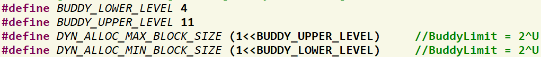
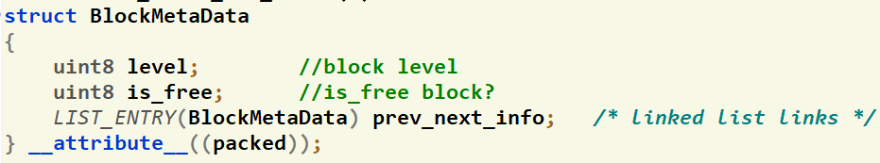
Dynamic Allocator – Given Data
Dynamic Allocator Constants
Metadata: contain block info with the prev-next pointer (to be used as list element)
Size of Metadata

Slide 20

Dynamic Allocator – Given Data
Refer to APPENDICES for:
LISTS Helper Macros
Free Block List of ALL sizes that holds elements of type BlockMetaData

Slide 21
Dynamic Allocator – Given Functions
Refer to APPENDICES for:
LISTS Helper Macros
Initialize the free block lists
void buddy_init()
Print the size of each list
void PrintFreeBlockLists()

Slide 22
#1: Get Block Size
Refer to APPENDICES for:
LISTS Helper Macros
uint32 get_block_size(void *va)
Description:
  Get the block size at the given VA from its corresponding BlockMetaData

Slide 23
#2: Allocate
Refer to APPENDICES for:
LISTS Helper Macros
void *alloc_block(uint32 required_size)
Description:
  Allocate new block with the given size
  For the actual size (given size + metadata), find its nearest pow-of-two
  Allocate new block according to the previously explained cases
  On success: return the start address of the allocated block (address after its metadata)
  On failure (or the requested size is 0): return NULL

Slide 24
#2: Allocate
Refer to APPENDICES for:
LISTS Helper Macros
void *alloc_block(uint32 required_size)
Description:
  Suggested pseudocode for “Get block” step
  If failure: call create_buddy_space()
  to allocate new page from Page Allocator
get_hole(int i)
{
if (i == (U + 1) <failure>;
if (<i_list empty>)
{
get_hole(i + 1);
<split hole into buddies>;
<put buddies on i_list>;
}
<take first hole on i_list>;
}

Slide 25
#3: Free
Refer to APPENDICES for:
LISTS Helper Macros
void free_block(void* va)
Description:
  Free the previously allocated block at the given address “va”
  Follow the previously explained steps
  If page becomes empty: call delete_buddy_space(va) to return the page to the Page Allocator

Slide 26

Kernel Heap
PART II: group modules

Slide 27
Objective
Allow the kernel to dynamically allocate/free data of different sizes in run-time

Slide 28
Kernel Heap
IMPORTANT NOTES
Enable the KERNEL HEAP: 'inc/memlayout.h' set USE_KHEAP by 1
This module is ESSENTIAL for all other modules
CAUTION
During your solution, any SHARED data MUST be PROTECTED by critical section via LOCKS

Slide 29
Kernel Heap – Functions
The main functions required to handle “Kernel Heap” are:
# | Function | File
1 | create_buddy_space | All essential declarations in: Kern/mem/kheap.h Functions definitions TO DO in: Kern/mem/kheap.c
2 | delete_buddy_space
3 | kmalloc
4 | kfree
5 | kheap_virtual_address
6 | kheap_physical_address
BONUS 1 | krealloc

Slide 30

Kernel Heap – What is new?
Current:
Kernel is one-to-one mapped to 256 MB RAM
Kernel can’t directly access beyond 256 MB RAM
Problem:
Virtual Memory
4 GB
Physical Memory
FOS
256 MB
RAM
UP TO 4 GB
KERNEL_BASE
256 MB
0

Slide 31

Kernel Heap – What is new?
Example:
Kernel can’t directly access beyond 256 MB RAM
Because it is NOT
valid VA..
New_PT1
VA = KERNEL_BASE +512 MB!!
.
.
.
256 MB
New PT0
VA = KERNEL_BASE + 20 KB
New DIR
VA = KERNEL_BASE + 16 KB
PA = 512 MB
New PT1
Frame#131,072
.
.
.
KERNEL_BASE
PA = 20 KB
New PT0
Frame#5
PA = 16 KB
New DIR
Frame#4
Program’s Virtual Memory
PA = 0
RAM

Slide 32
Kernel Heap – What is new?
Solution:
Kernel Heap for dynamic allocations (No 1-1 map)
KERNEL’S TABLES
ptr_page_directory
PT#984
1023
Empty
984
Kernel Heap
500000
0
0
F#4
New PT0
VA = KHS + 4K
984
0
0
New DIR
VA = KHS
PA = 2 GB
NEW PT0
Frame#500,000
Index of Kernel Heap PT
KERNEL_BASE
.
.
.
.
.
.
PA = 16 KB
New DIR
Frame#4
KHS = KERNEL_HEAP_START
RAM
Program’s Virtual Memory

Slide 33
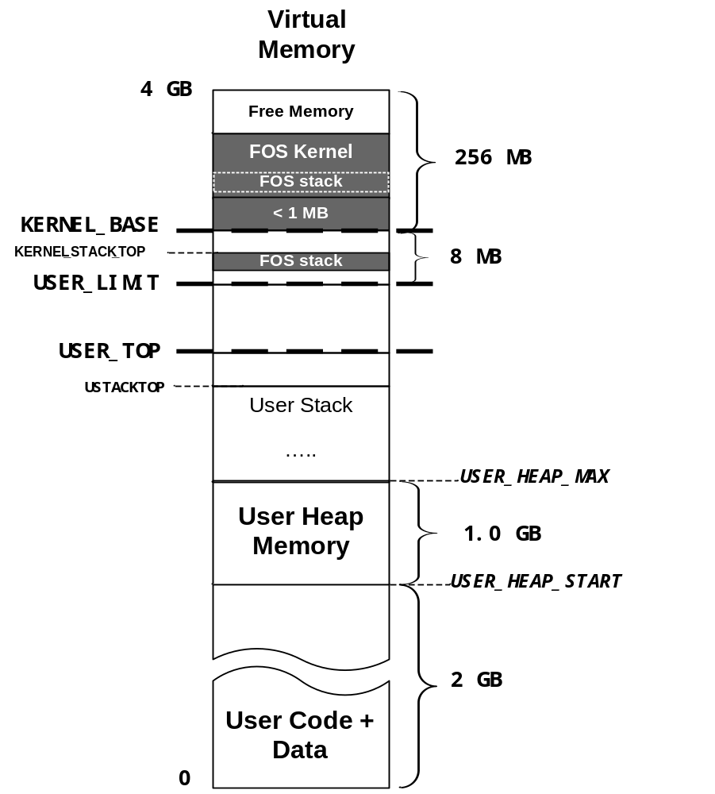
Kernel Heap – What is new?
KERNEL_HEAP_MAX
4 GB
KHEAP
KERNEL_HEAP_START
256 MB
Kernel Heap lies at the end of the virtual space
USTACKTOP
USTACKBOTTOM

Slide 34
Kernel Heap – Allocation Types?
There’re TWO types of allocator
Block Allocator
  Used to allocate small blocks (with size LESS OR EQUAL DYN_ALLOC_MAX_BLOCK_SIZE)
  Use Buddy System Functions
  Use Page Allocator to allocate/free pages of the Buddy System
Page Allocator
  Used to allocate chunk of pages (with size > DYN_ALLOC_MAX_BLOCK_SIZE)
  Allocation is done on page boundaries (i.e. internal fragmentation)
Range of both:
    USED Area: [KERNEL_HEAP_START, PAGE ALLOC BREAK)
    UNUSED Area: [PAGE ALLOC BREAK , KERNEL_HEAP_MAX)
KERNEL_HEAP_MAX
…
UNUSED
KERNEL HEAP
Page Alloc BREAK
USED
KERNEL_HEAP_START
…

Slide 35
Kernel Heap – Block Allocator
Use Buddy System with its data structure
The lists of the Buddy System are already initialized inside buddy_init() which is called inside:
int kheap_init(…) defined in kern/mem/kheap.c
This function, in turn, is already called in FOS_initialize() in init.c
Use Page Allocator to allocate/free pages of the Buddy System
void* create_buddy_space();
void delete_buddy_space(void *va);

Slide 36
Kernel Heap – Page Allocator
Allocation is done on page boundaries (multiple of 4KB)
  i.e. internal fragmentation can occur
ALL required pages should be allocated & mapped by OS
Allocation Strategy: CUSTOM FIT
KERNEL_HEAP_MAX
…
KERNEL HEAP
KERNEL_HEAP_START
…

Slide 37
Kernel Heap – Page Allocator
Has 2 limits defined in kern/mem/kheap.h:
  kheapPageAllocStart: begin of the kernel heap
  kheapPageAllocBreak: end of currently used area
malloc/free can move kheapPageAllocBreak up/down
KERNEL_HEAP_MAX
…
UNUSED
KERNEL HEAP
USED
kheapPageAllocBreak
Page Alloc BREAK
USED
kheapPageAllocStart
KERNEL_HEAP_START
…

Slide 38

Kernel Heap – Page Allocator
kmalloc(): dynamically allocate space
kfree(): delete a previously allocated space
Kfree()
Remove ALL Pages BUT NOT Tables
kmalloc()
ALL Pages Created in Memory
KERNEL HEAP
RAM
kheapPageAllocStart

Slide 39
Kernel Heap – Page Allocator (kmalloc)
Allocate pages on 4KB granularity
.
.
.
ptr3 = kmalloc (3 KB)
ptr3
3 KB
ptr2 = kmalloc (2.5 KB)
ptr2
2.5 KB
1 KB
4 KB
ptr1 = kmalloc (5 KB)
ptr1
.
.
.
KERNEL_HEAP_START

Slide 40
Kernel Heap – Page Allocator (kmalloc)
KERNEL_HEAP_MAX
.
.
.
UNUSED
ptr1 = kmalloc (1 MB)
UNUSED
CUSTOM FIT Strategy
1. Search for EXACT fit
2. if not found,
search for WORST fit till break
3. if not found,
extend BREAK if available
4. if not available,
return NULL
Required Complexity: bounded by
O(# FREE areas + # required pages)
ptr2 = kmalloc(1 MB)
ptr3 = kmalloc (3 MB)
kheapPageAllocBreak
ptr4 = kmalloc (1.5 MB)
2 MB
FREE
2 MB
ptr5
2.5 MB
ptr5 = kmalloc (2.5 MB)
1 MB
ptr1 = kmalloc (1 MB)
ptr1
1 MB
1 MB
1 MB
ptr3 = kmalloc (3 MB)
3 MB
ptr3
4 MB
ptr2 = kmalloc(1 MB)
ptr2
1 MB
2 MB
FREE
3 MB
ptr4 = kmalloc (1.5 MB)
ptr4
1.5 MB
4 MB
kheapPageAllocStart
x = kmalloc (12 KB)
O(2 + 12KB/4KB)

Slide 41
Kernel Heap – Page Allocator (kfree)
KERNEL_HEAP_MAX
.
.
.
UNUSED
UNUSED
Make sure to:
1. Merge adjacent blocks
2. Update the kheapPageAllocBreak if freeing the last space
Required Complexity: bounded by
O(# FREE areas + # freed pages)
kheapPageAllocBreak
ptr5
2.5 MB
kfree (ptr5)
2 MB
FREE
2 MB
1 MB
kfree (ptr1)
ptr1
1 MB
1 MB
1 MB
FREE
4MB Free
3 MB
kfree (ptr3)
3MB Free
ptr3
4 MB
kfree (ptr2)
ptr2
1 MB
2 MB
FREE
3 MB
ptr4
1.5 MB
O(3 + 1.5MB/4KB)
4 MB
kfree (ptr4)
kheapPageAllocStart

Slide 42
Kernel Heap – Page Allocator
kheap_physical_address(): find physical address of the given kernel one
kheap_virtual_address(): find kernel virtual addr of the given physical one
IMP: Both MUST be Efficient ~O(1)
kheap_physical_address()
Get pa of the given va
kheap_virtual_address()
Get va of the given pa
KERNEL HEAP
RAM
pa
pa
va
va

Slide 43
Kernel Heap – Given Functions
Refer to APPENDICES for:
LISTS Helper Macros
void kheap_init()
Description:
  Initialize the free block lists of Buddy System (by calling buddy_init())
  Set default strategy of page allocator to be CUSTOM_FIT
  Initialize kheapPageAllocStart & kheapPageAllocBreak to KERNEL_HEAP_START

Slide 44
#4: create_buddy_space()
void* create_buddy_space();
Description:
  Allocate a new page from the Page Allocator and return its address
  Mark this page as a “Buddy System Page” to differentiate it from Page Allocator pages

Slide 45
#5: delete_buddy_space()
void delete_buddy_space(void *va)
Description:
  Delete the page at the given va from the Page Allocator
  Unmark it

Slide 46
#6: kmalloc()
void* kmalloc(unsigned int size)
Description:
  If size ≤ DYN_ALLOC_MAX_BLOCK_SIZE: [BLOCK ALLOCATOR]
    Use Buddy System to allocate the required space
    Possibly invoke the Page Allocator to create_buddy_space()
  Else: [PAGE ALLOCATOR]
    Allocate & map the required space on page-boundaries using EFFICIENT CUSTOM FIT strategy
  If failed to allocate: return NULL
  It should be bounded by O(# FREE areas + # required pages)

Slide 47
#7: kfree()
void kfree(void* virtual_address)
Description:
  If the virtual address belong to a “Buddy System Page” [BLOCK ALLOCATOR]
    Use Buddy System to free the given address
    Possibly invoke the Page Allocator to delete_buddy_space()
  Else if virtual address inside the Heap [PAGE ALLOCATOR]
    FREE the space of the given address from RAM
  Else (i.e. invalid address): should panic(…)
  It should be bounded by O(# FREE areas + # freed pages)

Slide 48
#8: kheap_physical_address()
unsigned int kheap_physical_address(unsigned int virtual_address)
Description:
  return the physical address corresponding to given virtual_address (including offset)
  If no mapping, return 0.
  It should work for both [BLOCK ALLOCATOR] and [PAGE ALLOCATOR]
  It should run in O(1)

Slide 49
#9: kheap_virtual_address()
unsigned int kheap_virtual_address(unsigned int physical_address)
Description:
  return the virtual address corresponding to given physical_address (including offset)
  If no mapping, return 0.
  It should work for both [BLOCK ALLOCATOR] and [PAGE ALLOCATOR]
  It should run in O(1)

Slide 50
BONUS#1: krealloc()
void *krealloc(void *virtual_address, uint32 new_size)
Description:
  Attempts to resize the allocated space at given virtual address to "new size" bytes, possibly moving it in the heap.
  If successful, returns the new virtual address.
  On failure, returns a NULL pointer, and the old virtual address remains valid.
  A call with virtual_address = null is equivalent to kmalloc()
  A call with new_size = zero is equivalent to kfree()
  It should work in [BLOCK ALLOCATOR] , [PAGE ALLOCATOR] and CROSS-ALLOCATORS

Slide 51

Fault Handler I (Placement)
PART II: group modules

Slide 52
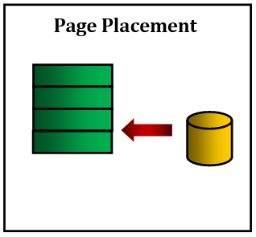
Objective
Handle the page fault exception by retrieving the faulted page from H.D.D to memory

Slide 53
Load Program [env_create]
Now: in Project
THREE kernel dynamic allocations:
create_page_table(): create new page table and link it to directory.
create_user_directory(): create new user directory.
create_user_kern_stack(…): create new user kernel stack.
env_create( )
BIN
Set of pages
Required Tables
DONE
All Pages
BIN
Segment 1, page 1
Loaded in virtual address 201000
201000
WS_Last_element
Segment 1, page 2
Loaded in virtual address 202000
202000
REQUIRED
Segment 1, page 3
203000
Loaded in virtual address 203000
Segment 2, page 1
801000
Refer to APPENDICES for:
Loaded in virtual address 801000
Segment 2, page 2
USTAKTOP —PAGESIZE
NOT Loaded in main memory
Page File Helper Functions
Program Binary Segments and pages
Working Set after loading (pages_WS_size = 5)
First Stack Page
Working Set Structure & Helper Functions

Slide 54
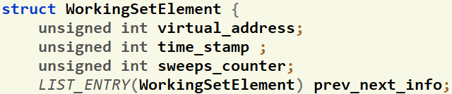
Working Set: Structure
inc/environment_definitions.h
struct Env
{
struct WS_List page_WS_active_list; //ActiveList that should work as FIFO
struct WS_List page_WS_second_list; //SecondList that should work as LRU
int page_WS_max_size ; //Max allowed WS Size for both Lists
int page_2nd_WS_size ; //Max allowed size of SecondList
struct WorkingSetElement* page_last_WS_element;
Each Element
Proc Limit
LRU 2nd List Size
Each process has two working set LISTs that are initialized in env_create()
The max total size is set in "page_WS_max_size" during the env_create()
"page_2nd_WS_size" will hold the max size of the 2nd list (in case of FIFO, it equals ZERO)
"page_last_WS_element" will point to either:
  First location in the Active WS If the list is full.
  Null if the list is not full.
inc/environment_definitions.h
This list hold pointers to struct containing info about the currently loaded pages in memory.
Each struct holds important values about each page:
  User virtual address of the page
  Previous & Next pointers to be used by list

Slide 55
Working Set: Functions [GIVEN]
struct WorkingSetElement* env_page_ws_list_create_element (struct Env* e, uint32 virtual_address)
Description:
  Allocate a new object of struct WorkingSetElement (using kmalloc())
  Initialize it by the given virtual address
  Return
    On success: pointer to the created object
    On failure: kernel should panic()

Slide 56
Working Set: Functions [GIVEN]
void env_page_ws_print(struct Env* e)
Description:
Print the page working set virtual addresses together with used, modified & buffered bits.
It also shows where the page_last_WS_element of the working set is point to

Slide 57
Working Set: Functions [GIVEN]
void env_page_ws_invalidate(struct Env* e, uint32 virtual_address)
Description:
Search for the given virtual address inside the working set of “e” , if found:
  Remove its WS element from the list
  Delete this element from the kernel memory (using kfree())
  Unmap the page from the address space

Slide 58
#10: Kernel Dyn. Alloc. for a Process
void* create_user_kern_stack(uint32* ptr_user_page_directory)
Description:
  Create a user kernel stack of size KERNEL_STACK_SIZE
  Mark its bottom page as NOT PRESENT (GUARD page)
  Return
    On success: pointer to the created stack
    On failure: kernel should panic()

Slide 59
Fault Handler I: Overview
The main functions required to handle “Page Fault” are:
# | Function | File
1 | fault_handler | Functions definitions TO DO in: kern/trap/fault_handler.c
2 | page_fault_handler

Slide 60
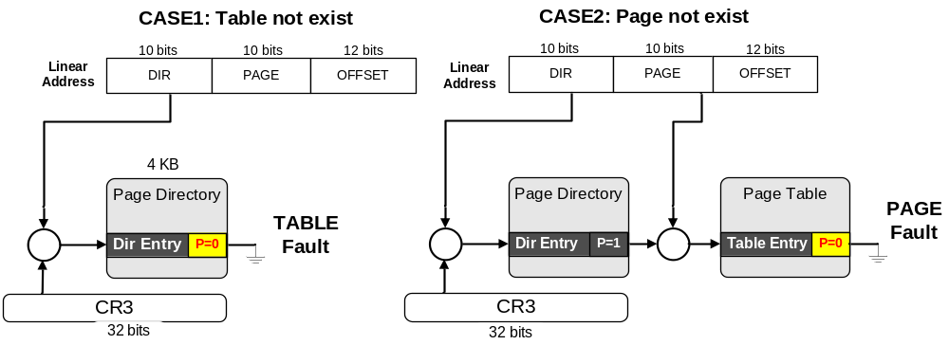
Fault Handler I: Overview
Fault: is an exception thrown by the processor (MMU) to indicate that:
  A page table not exist in the main memory (i.e. new table). (see the following figure) OR
  A page can’t be accessed due to either it’s not present in the main memory

Slide 61
#11: Check Invalid Pointers
void fault_handler(struct Trapframe *tf)
Description:
  Check the faulted_va on the following:
  Pointing to UNMARKED page in user heap (i.e. its PERM_UHPAGE should equals 0)
  Pointing to kernel
  Exist with read-only permissions
  If invalid (any of above occur): it must be rejected without harm to the kernel or other running processes, by exiting the process using env_exit()

Slide 62
#12: Placement
Refer to APPENDICES for:
Page File Helper Functions
Working Set Struct & Helper Func’s
page_fault_handler(struct Env * falulted_env, uint32 fault_va)
  if the size of both WS Lists < max total size, then do
  {
if(isPageReplacmentAlgorithmFIFO()) {
  Scenario 1: Placement
    //TODO: [1] PAGE FAULT HANDLER – FIFO Placement
    Allocate space for the faulted page
    Read the faulted page from page file to memory
    If the page does not exist on page file, then
      If it is a stack or a heap page, then, it’s OK.
      Else, it must be rejected without harm to the kernel or other running processes, by exiting the process.
    Reflect the changes in the page working set list (i.e. add new element to the list tail) }
}

Slide 63
Blocking
PART II: group modules

Slide 64
Objective
Implement Kernel-based primitives to support the blocking on I/O

Slide 65
Blocking
REMEMBER
During your solution, any SHARED data need to be PROTECTED by critical section via LOCKS

Slide 66
Blocking
The main functions required to implement “Channel” are:
# | Function | File
1 | sleep() | Declarations: kern/conc/channel.h definitions TO DO: kern/conc/channel.c
2 | wakeup_one()
3 | wakeup_all()
4 | acquire_sleeplock() | Declarations: kern/conc/sleeplock.h definitions TO DO: kern/conc/sleeplock.c
5 | release_sleeplock()

Slide 67
Blocking: Intro
Locks provide two atomic operations:
  Lock.acquire() – wait until lock is free; then mark it as busy
    After this returns, we say the calling thread holds the lock
  Lock.release() – mark lock as free
    Should only be called by a thread that currently holds the lock
    After this returns, the calling thread no longer holds the lock
Negatives of interrupt-based implementation:
  Can’t give lock implementation to users
  Doesn’t work well on multiprocessor
Negatives of SpinLocks:
  Busy-waiting
  Cache coherence

Slide 68
Blocking: SleepLock
Idea: only busy-wait to atomically check lock value
Note: unlike previous solution, the critical section is very short
Note: WHY there’s a while (not if) in the acquire?
Note: sleep must be sure to reset the guard variable. WHY can’t we do it just before or after the sleep?
SpinLock guard = FREE;
int mylock = FREE; //Interface: acquire(&mylock); release(&mylock);
acquire(int *thelock) {
acquire_spinlock(&guard)
while (*thelock == BUSY) {
put thread on wait queue;
go to sleep()
// guard == BUSY on wakeup!
}
*thelock = BUSY;
release_spinlock(&guard);
}
}
release(int *thelock) {
acquire_spinlock(&guard)
if anyone on wait queue {
wake-up ALL blocked processes
}
*thelock = FREE;
release_spinlock(&guard);
}
& release guard

Slide 69
Blocking: SleepLock
What about release guard when going to sleep?
Before Putting thread on the wait queue?
  Release can check the queue and not wake up thread ➔ missing wake-up
After putting the thread on the wait queue
  Release puts the thread on the ready queue, but the thread still thinks it needs to go to sleep
  Miss wakeup and still holds lock (deadlock!)
Want to put it after sleep(). But – how?
  In Sleep: Protect the process queue(s) then release the guard. This ensures no missing wake-up even if release is called.
SpinLock guard = FREE;
int mylock = FREE;
acquire(int *thelock) {
acquire_spinlock(&guard)
while (*thelock == BUSY) {
put thread on wait queue;
go to sleep()
// guard == BUSY on wakeup!
}
*thelock = BUSY;
release_spinlock(&guard);
}
}
Release Position
Release Position
Release Position
& release guard

Slide 70
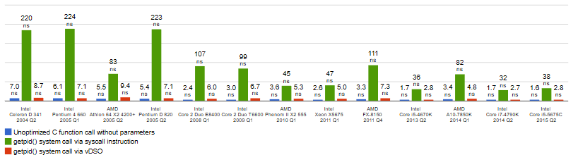

Blocking: SleepLock
Positives
  Machine can receive interrupts
  User code can use this lock
  Works on a multiprocessor
  No Busy-Waiting
Negatives
  Need system call in sleep() & wakeup()
    Min System call ~ 25x cost of function call
Usually used for
long-time critical section
EX: INITIALIZING 2D MATRIX 2000x2000
SYSTEM CALL RANDOM FUNCTION ➔ 190 secs
USER-SIDE RANDOM FUNCTION ➔ 5 secs
SPEEDUP FACTOR $≈$ 38x

Slide 71
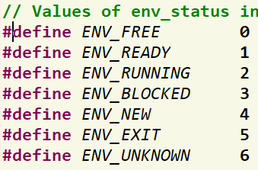
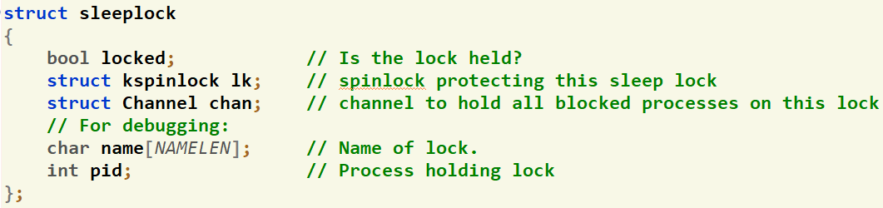
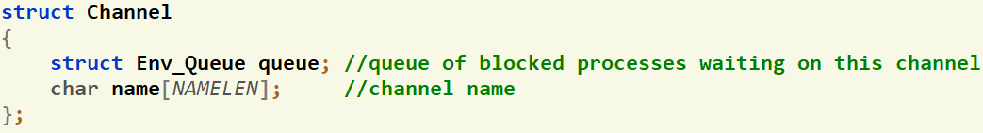
Blocking: Given Data Structures
Process Status
(inc/environment_definitions.h)
Complete implementation of SpinLock (kern/conc/kspinlock.h & .c)
SpinLock to protect ANY process queue (kern/cpu/sched.h)
Struct declaration of the SleepLock (kern/conc/sleeplock.h)
Struct declaration of the Channel (kern/conc/channel.h)
ProcessQueues.qlock

Slide 72
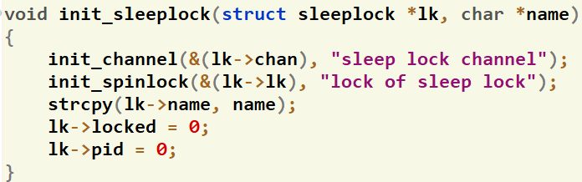
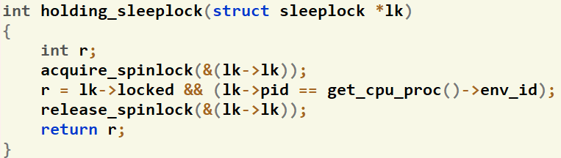
Blocking: Given Functions
Initialize the SleepLock (kern/conc/sleeplock.c)
Check whether the lock is held or not? (kern/conc/sleeplock.c)

Slide 73
Blocking: Given Functions
Get the current running process (kern/proc/user_environment..c)
Insert a process into the ready queue (kern/cpu/sched_helpers.c)
Queues functions: (kern/cpu/sched_helpers.c)
Invoke the scheduler to context switch into the next ready queue (if any) (kern/proc/user_environment..c)
struct Env* get_cpu_proc();
void sched_insert_ready(struct Env* p);
int queue_size(struct Env_Queue* queue);
void enqueue(struct Env_Queue* queue, struct Env* env);
struct Env* dequeue(struct Env_Queue* queue);
void sched();

Slide 74
#13: Sleep on Channel
Blocking: Required Functions
void sleep(struct Channel *chan, struct spinlock* lk);
Description:
  Should block the current running process on the given chan and schedule a next ready one
  It should release the given lk before being blocked so that other process(es) can use it
  It should reacquire the given lk again when awakened.
GENERAL NOTE: make sure to protect any process queue using the suitable lock

Slide 75
#14: Wake-up ONE in Channel
Blocking: Required Functions
void wakeup_one(struct Channel *chan)
Description:
  Should wake-up ONE blocked process in the given chan and change it to ready
GENERAL NOTE: make sure to protect any process queue using the suitable lock

Slide 76
#15: Wake-up ALL in Channel
Blocking: Required Functions
void wakeup_all(struct Channel *chan)
Description:
  Should wake-up ALL blocked process(es) in the given chan and change them to ready
GENERAL NOTE: make sure to protect any process queue using the suitable lock

Slide 77
#16: Acquire Sleep Lock
Blocking: Required Functions
void acquire_sleeplock(struct sleeplock *lk)
Description:
  Should acquire the given sleep lock lk
  If successfully acquired, continue
  If failed, block the process on the corresponding channel
  Refer to the previously explained pseudocode
GENERAL NOTE: make sure to protect any process queue using the suitable lock

Slide 78
#17: Release Sleep Lock
Blocking: Required Functions
void release_sleeplock(struct sleeplock *lk)
Description:
  Should release the given sleep lock lk by waken-up ALL blocked processes on it
  Refer to the previously explained pseudocode
GENERAL NOTE: make sure to protect any process queue using the suitable lock

Slide 79

NEXT, IT’S YOUR TURN...
☺ Enjoy developing your own OS ☺

